Slide 1

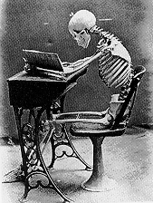
Forensic Anthropology: Studying Bones
What types of information can we gather from studying bones as evidence?

Slide 2
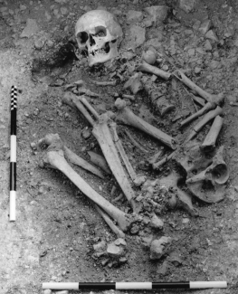
Forensic Anthropology
The use of knowledge of the skeletal system to identify crime victims and determine cause and circumstance of death.

Slide 3
What role do anthropologists play in solving crimes?Watch the video and then answer the questions.
1. What does a physical anthropologist investigate?
2.What four things do we want to know about a skeleton?
3.What bones are most useful for developing a profile of a person? Explain how they are used.

Slide 4
Is it human or animal?
The study of bones is called osteology.
Humans and animals have different skeletal structures, different bones and differently shaped bones.
Microscopically, bones contain holes, or osteons, that carry blood. Animal osteons form a regular pattern, while those in humans do not.

Slide 5
The Skeleton
An adult human has 206 bones!
The skeleton provides structure and protection.
Muscles are connected to bone by tendons; bones are connected to each other and joints by ligaments.
Bones are classified into four groups:
long—arms, legs, hands, feet
short—wrist, ankle
flat—skull, scapula, sternum, hip, ribs
irregular—vertebrae, skull

Slide 6
A Caveat
Informative features about the age, sex, race and stature of individuals based on bones is based on biological differences between sexes and races (males are generally taller and more robust) as well as differences due to ancestry (certain skeletal features of the skull)
Imprecise
  Due to variation
Nevertheless, differences do exist and the more features you survey, the more precise your conclusions will be

Slide 7
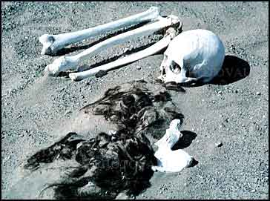
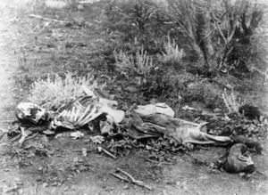
What Can We Learn?
Determination of Sex
  Pelvis
  Skull
  (Long Bones)
Determination of Race
  Skull
Approximate Age
  Growth of long bones
Approximate Stature
  Length of long bones
Postmortem or antemortem injuries
Postmortem interval (time of death)
http://en.wikipedia.org/wiki/Forensic_anthropology

Slide 8
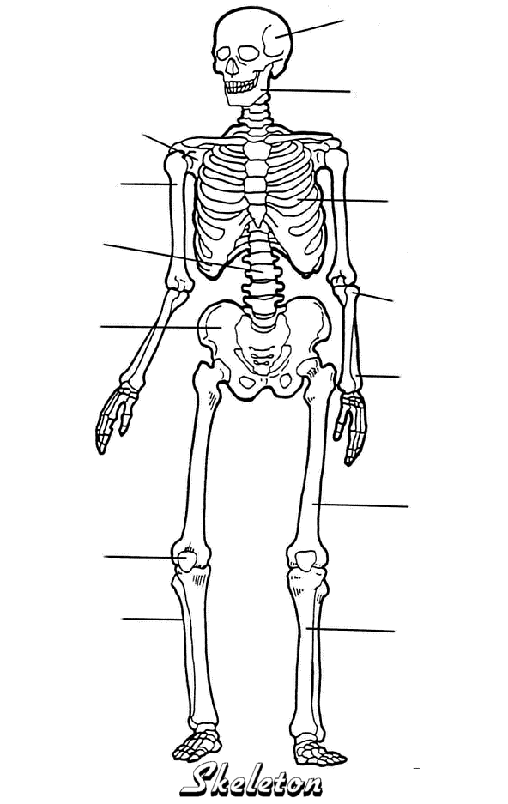
The bones we’re interested in
Skull
Humerus
Pelvis
Femur
Tibia

Slide 9
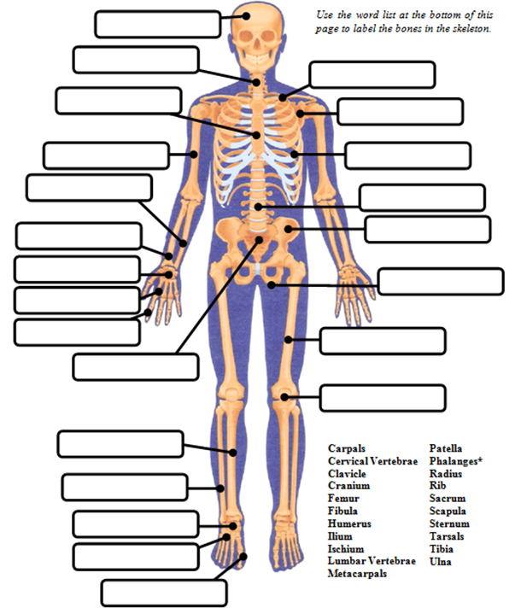






















Cervical Vertebrae

Slide 10
Directional Vocabulary
Anterior – Front of a person
Posterior – rear of the person
Caudal – towards the feet of a person
Cranial – towards the head of a person
Deep – further from the surface
Distal – part of the limb furthest from the body
Dorsal – along the back
Frontal plane – body plane that divides the person into dorsal and ventral parts
Lateral – side of a person
Mid-Sagittal – body plane that divides the person into “equal” right and left halves
Proximal – part of the limb closest to the body
Superficial – closer to the surface
Transverse – body plane that divides the body into cranial and caudal parts
Ventral – along the belly surface

Slide 11
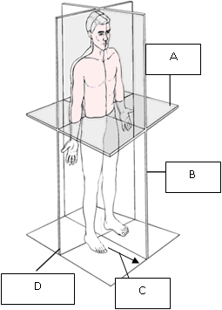

Slide 12
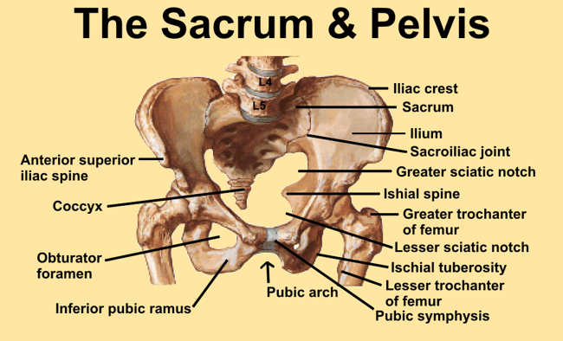

Slide 13
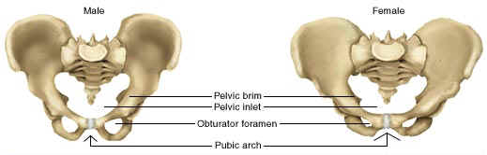
Determination of Sex: Pelvis
Pelvis (differences due to adaptations to childbirth)
1. females have wider subpubic angle (> 90°)
2. females have a broad pelvic inlet
2.
2.
1.
1.

Slide 14
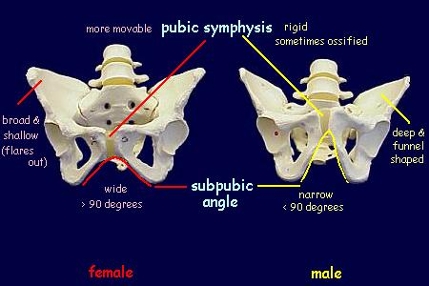
Determination of Sex
3. females have a broad, shovel-like ilium
4. females have a flexible pubic symphysis
5. females have a wider sciatic notch
4.
3.
3.
5.
5.

Slide 15
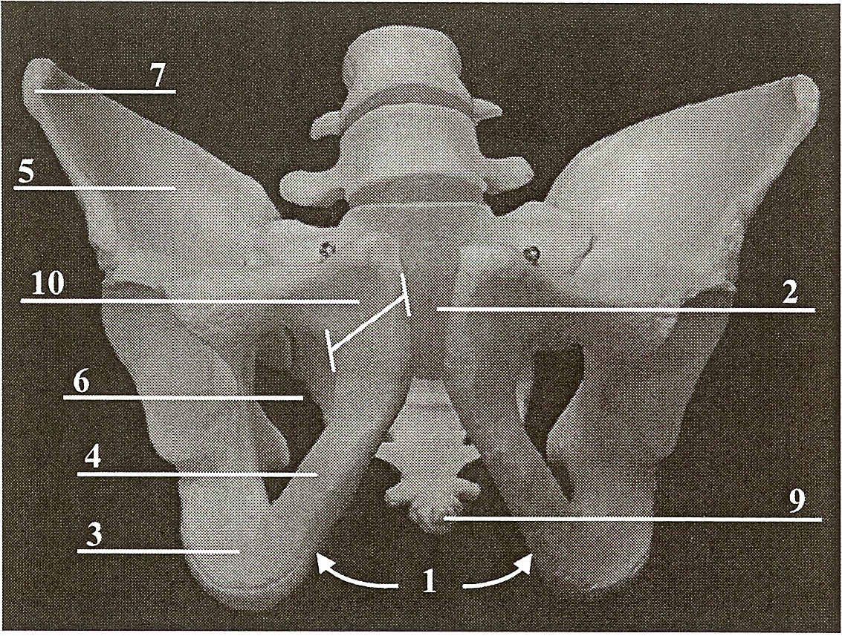
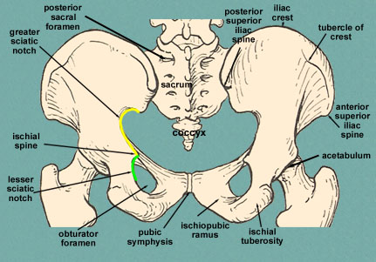
Sex Determination - Pelvis
Sub-Pubic Angle
Pubis Body Width
Greater Sciatic Notch
Pelvic Cavity Shape
http://mywebpages.comcast.net/wnor/pelvis.htm

Slide 16
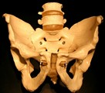
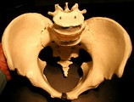
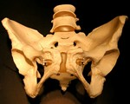
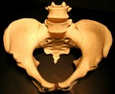
Male vs. female pelvis

Slide 17
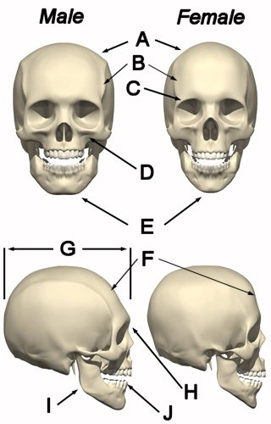
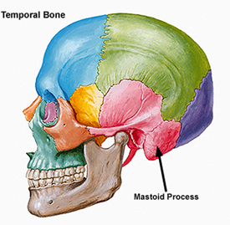
Determination of Sex: Cranium
Crests and ridges more pronounced in males (A, B, C)
Chin significantly more square in males (E)
Mastoid process wide and robust in males
Forehead slopes more in males (F)

Slide 18
Sex Determination - Skull
Trait | Female | Male
Upper Edge of Eye Orbit | Sharp | Blunt
Shape of Eye Orbit | Round | Square
Zygomatic Process (“cheekbone”) | Not expressed beyond external auditory meatus (ear-hole in skull) | Expressed beyond external auditory meatus
Nuchal Crest (Occipital Bone) | Smooth | Rough and bumpy
External Occipital Protuberance | Generally Absent | Generally present
Frontal Bone | Round, globular | Low, slanting
Mandible shape | Rounded, V-shaped | Square, U-shaped
Ramus of mandible (back of jaw) | Slanting | Straight

Slide 19
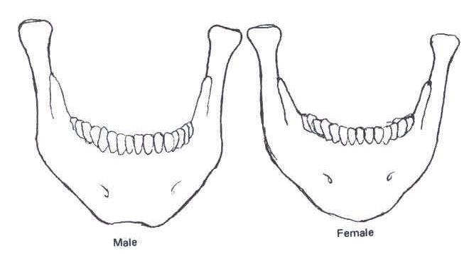

Slide 20
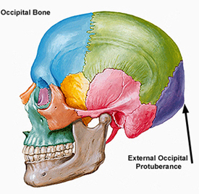

Slide 21
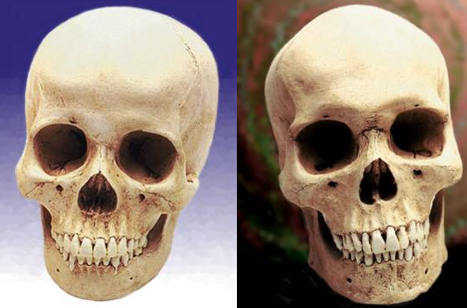
Analyze these two skulls. Determine the gender of each using your notes. Write a thorough explanation of your findings.
A
B

Slide 22
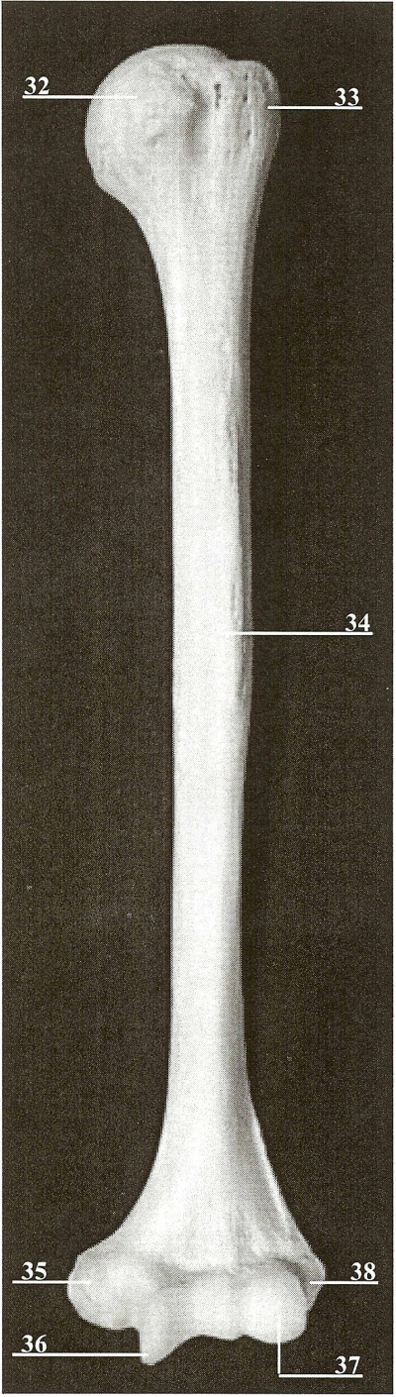
Determination of Sex: Long Bones
Normally, the long bones alone are not used alone to estimate gender. However, if these bones are the only ones present, there are characteristics that can be used for sex determination.
E.g. maximum length of humerus in females is 305.9 mm, while it is 339.0 mm in males

Slide 23
Determination of Race
Difficulties
  3 race system is broad: Caucasian (European), Mongoloid (Asian), and African (African and West Indian).
  Some will have traits completely inconsistent with their geographic origin.
  Mixed-racial ancestry
    Some exhibit characteristics of more than one racial group.
  Indicators are not measurable and are therefore subjective.
Despite these drawbacks, race determination is viewed as a critical part of the overall identification of an individual's remains.

Slide 24
Caucasian, Mongoloid, African
From: Beyers, S.N. (2005). Introduction to Forensic Anthropology

Slide 25
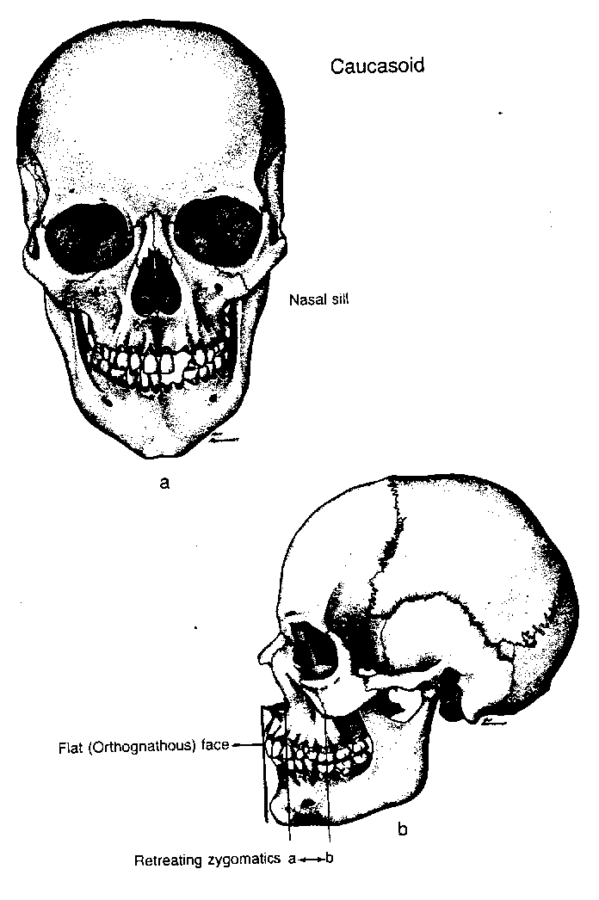
Features of the Skull Used in Race Determination
Nasal index: The ratio of the width to the height of the nose, multiplied by 100
Nasal Spine
Feel the base of the nasal cavity, on either side of the nasal spine – you will feel sharp ridges (nasal silling), rounded ridges, or no ridges at all (nasal guttering)
Prognathism: extent of lower jaw
Shape of eye orbits (round or square
Nasal spine

Slide 26
Nasal Silling and Guttering
From: Beyers, S.N. (2005). Introduction to Forensic Anthropology

Slide 27
General Shapes of the Eye Orbits
From: Beyers, S.N. (2005). Introduction to Forensic Anthropology

Slide 28
Determination of Race:
Caucasian
Trait
Nasal Index: | <48
Nasal Spine: | Prominent spine
Nasal Silling / Guttering: | Sharp ridge (silling)
Prognathism: | Straight
Shape of Orbital Openings: | Oval, angled
Orbital openings:
oval
Nasal spine:
Prominent
Progathism: straight
http://upload.wikimedia.org/wikipedia/en/c/cc/Skullcauc.gif

Slide 29
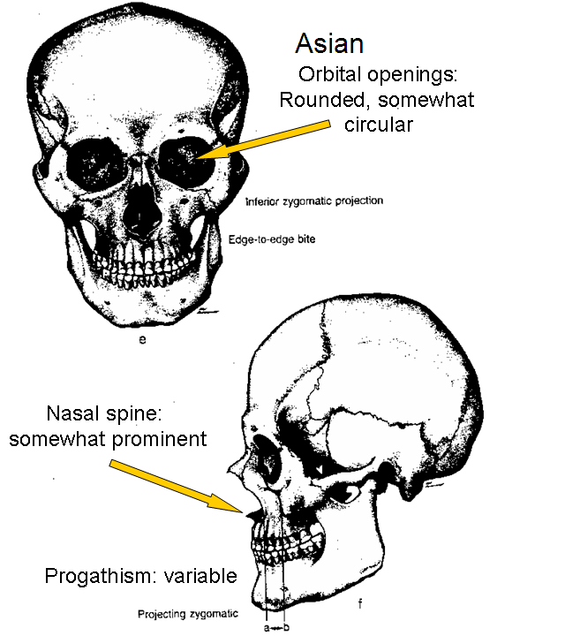
Determination of Race:
Mongoloid (Asian decent and Native American decent)
Trait
Nasal Index | 48-53
Nasal Spine | Somewhat prominent spine
Nasal Silling/ Guttering | Rounded ridge
Prognathism | Variable
Shape of Orbital Openings | Rounded, somewhat circular
http://upload.wikimedia.org/wikipedia/en/b/b3/Skullmong.gif

Slide 30
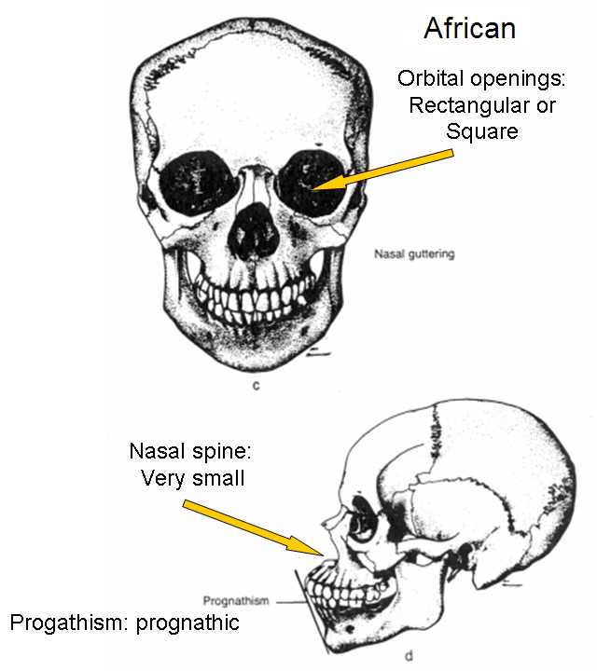
Determination of Race:
African: (everyone of African decent and West Indian decent)
Trait
Nasal Index | >53
Nasal Spine | Very small spine
Nasal Silling/ Guttering | No ridge (guttering)
Prognathism | Prognathic
Shape of Orbital Openings | Rectangular or square
http://upload.wikimedia.org/wikipedia/en/5/5e/Skullneg.gif

Slide 31
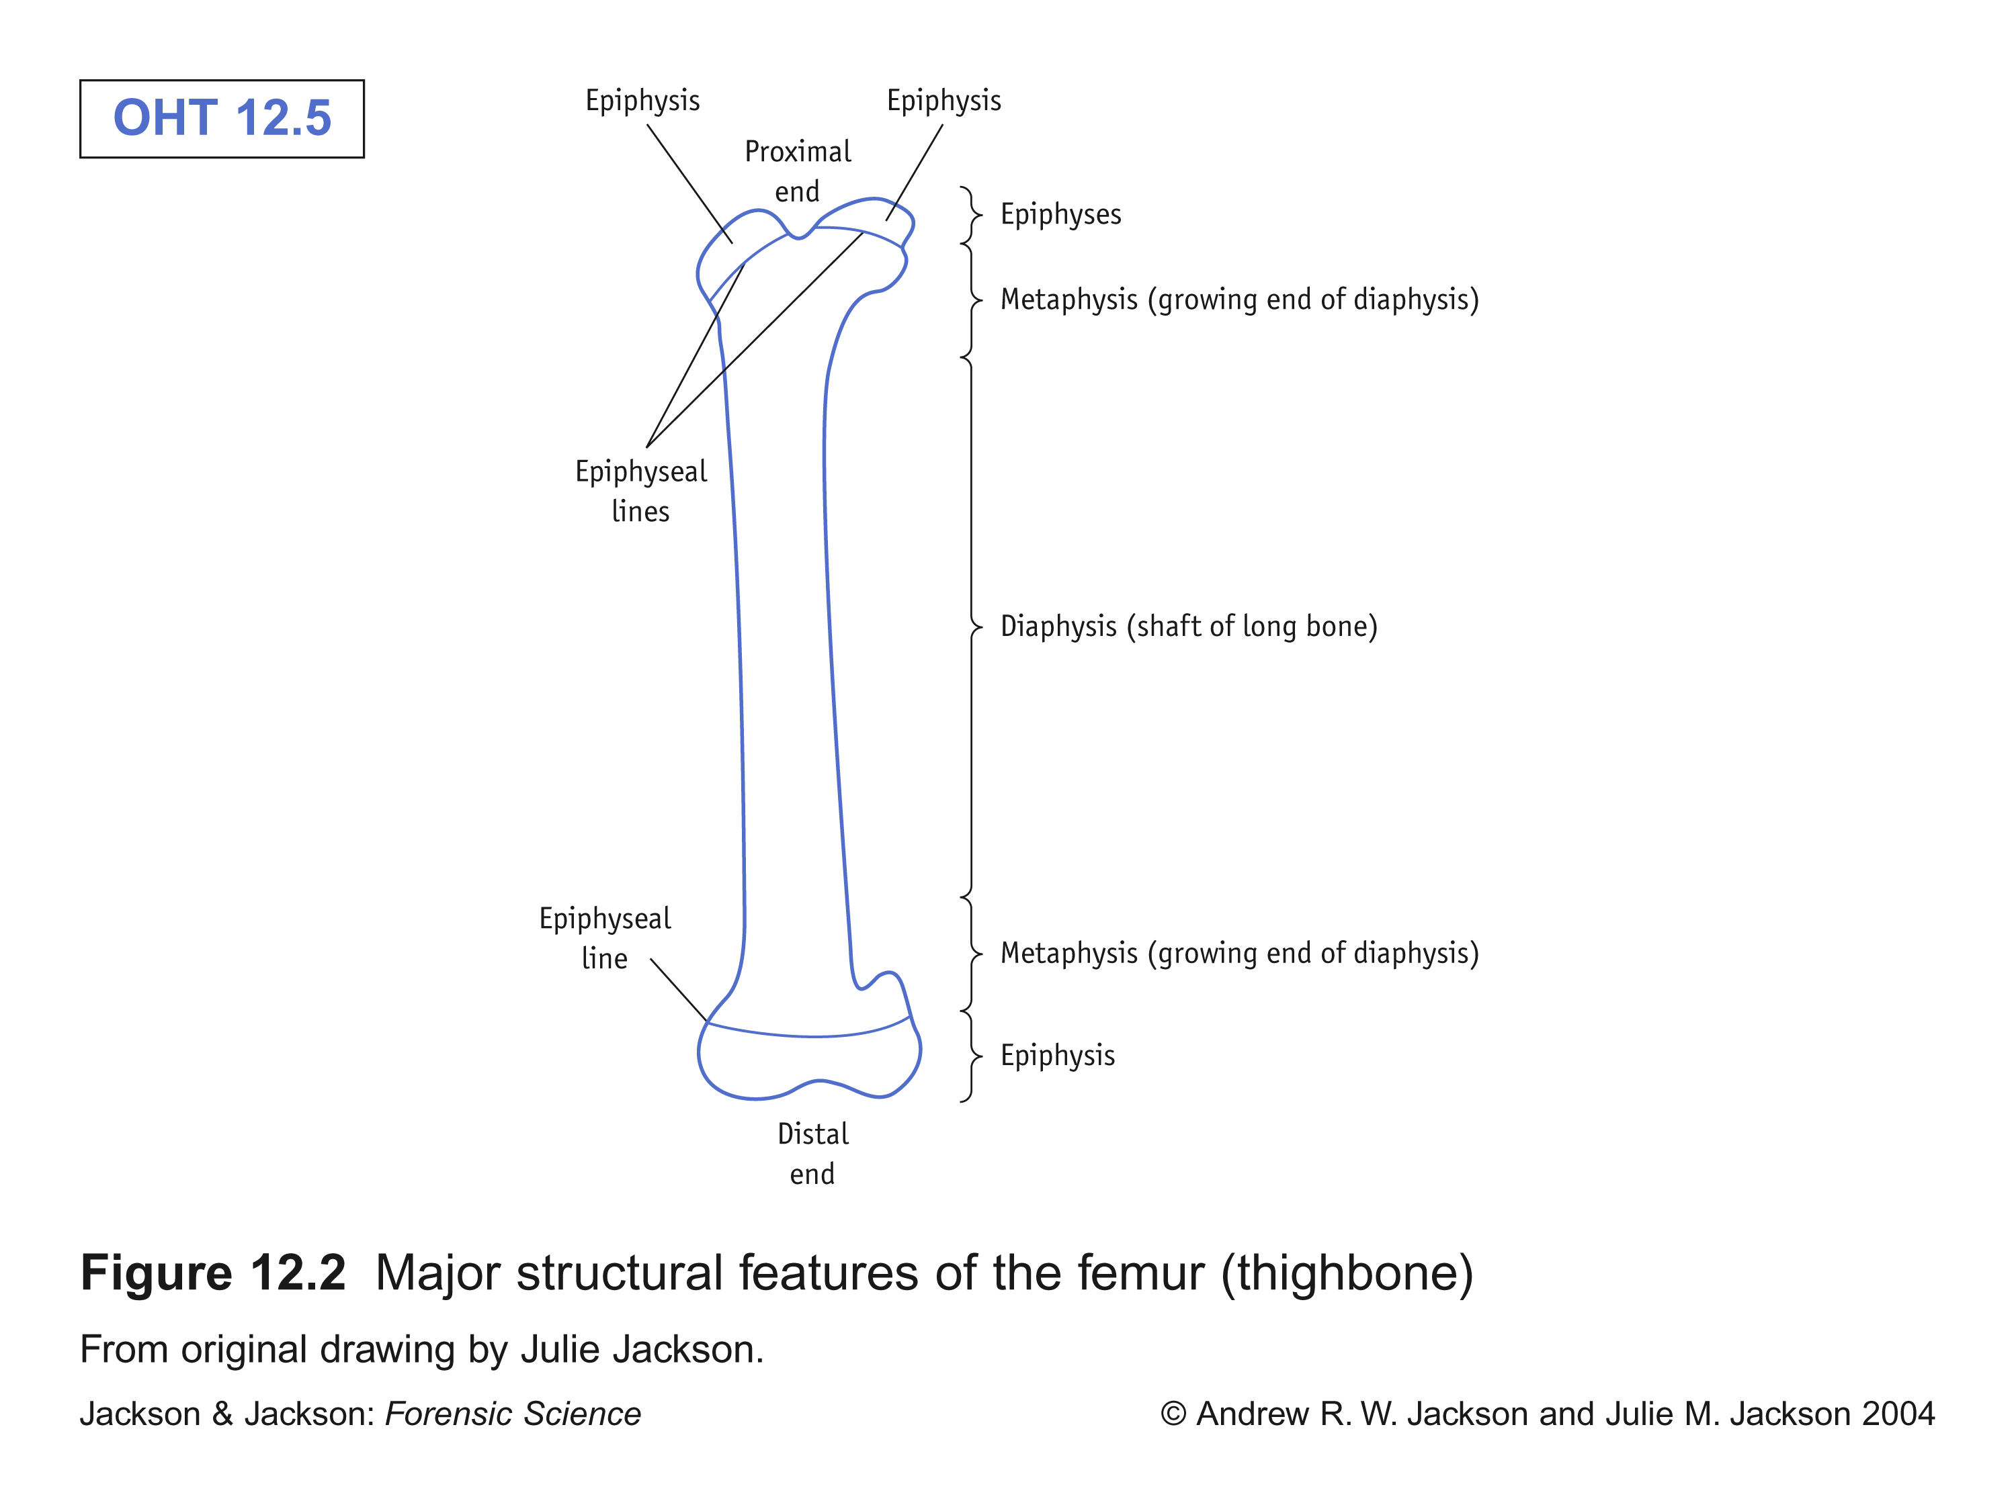
Determination of Age
The long bones are those that grow primarily by elongation at an epiphysis at one end of the growing bone. The long bones include the femurs, tibias, and fibulas of the legs, the humeri, radii, and ulnas of the arms, and the phalanges of the fingers and toes.
As a child grows the epiphyses become calcified (turn to hard bone)

Slide 32
Determination of Age from Bones
Ages 0-5: teeth are best – forensic odontology
  Baby teeth are lost and adult teeth erupt in predictable patterns
Ages 6-25: epiphyseal fusion – fusion of bone ends to bone shaft
  epiphyseal fusion varies with sex and is typically complete by age 25
Ages 25-40: very hard
Ages 40+: basically wear and tear on bones
  periodontal disease, arthritis, breakdown of pelvis, etc.
Can also use ossification of bones such as those found in the cranium

Slide 33
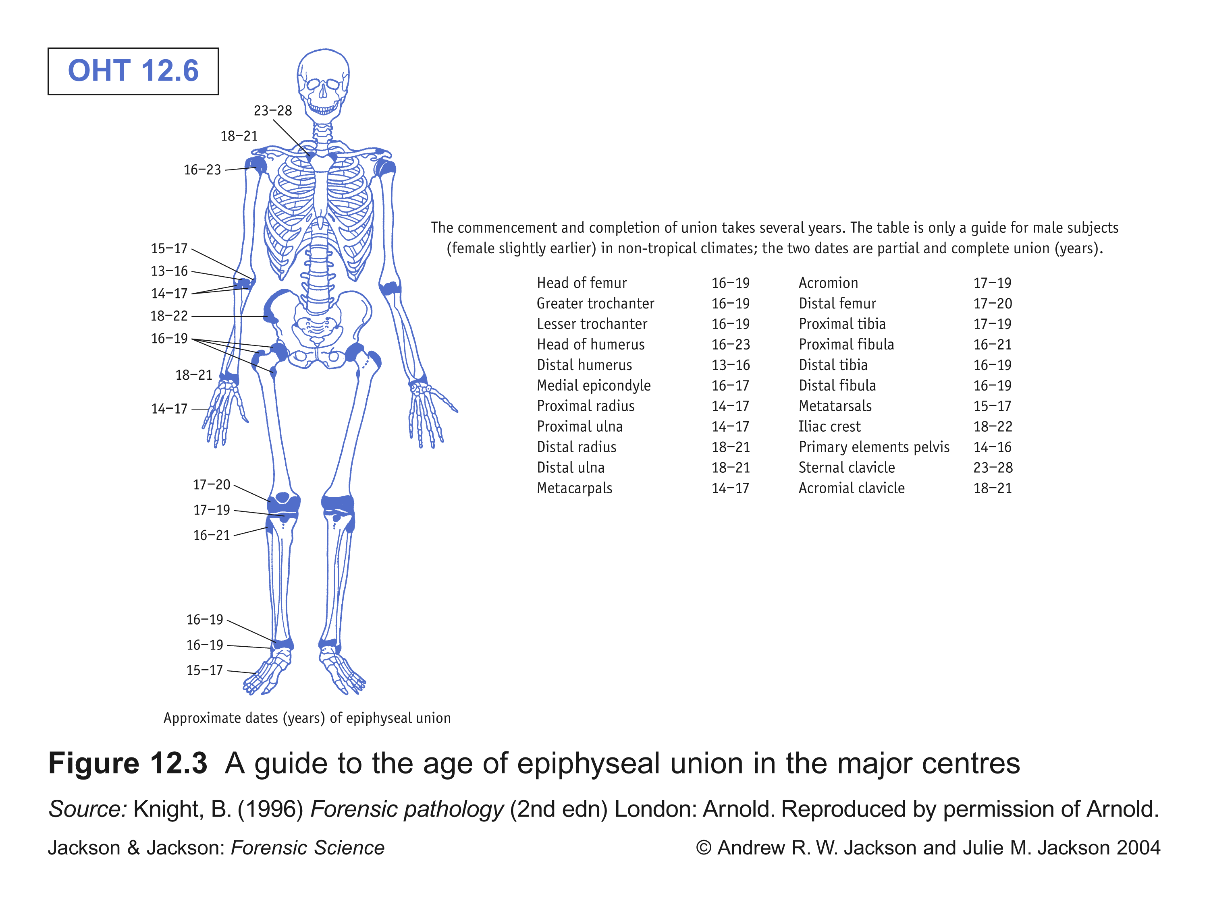
Epiphyseal Fusion:
A General Guide

Slide 34
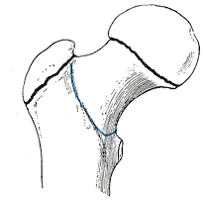
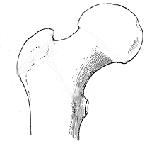
Epiphyseal Fusion
The figures below are of the Epiphyses of the femur or thigh bone (the ball end of the joint, joined by a layer of cartilage).
The lines in the illustrated Image 1 show the lines or layers of cartilage between the bone and the epiphyses. The lines are very clear on the bone when a person, either male or female is not out of puberty.
In Image 2, you see no visible lines. This person is out of puberty. The epiphyses have fully joined when a person reaches adulthood, closing off the ability to grow taller or in the case of the arms, to grow longer.
Figure 1.
Figure 2.

Slide 35
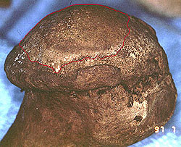
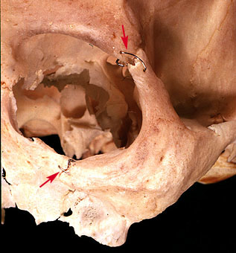
Determination of Age from Bone: Signs of wearing and antemortem injury
Occupational stress wears bones at joints
Surgeries or healed wounds aid in identification
http://library.med.utah.edu/kw/osteo/forensics/pos_id/boneid_th.html

Slide 36
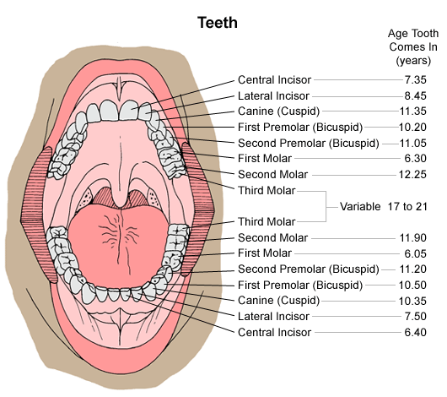
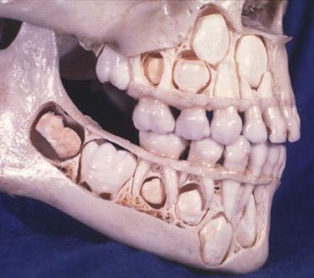
2. Age Determination: Use of Teeth
http://images.main.uab.edu/healthsys/ei_0017.gif
http://www.forensicdentistryonline.org/Forensic_pages_1/images/Lakars_5yo.jpg

Slide 37
Determination of Stature
Long bone length (femur, tibia, humerus) is proportional to height
There are tables that forensic anthropologists use (but these also depend to some extent on race)
Since this is inexact, there are ‘confidence intervals’ assigned to each calculation.
For example, imagine from a skull and pelvis you determined the individual was an adult Caucasian, the height would be determined by:
Humerus length = 30.8 cm
Height = 2.89 (length of humerus) + 78.10 cm
  = 2.89 (30.8) + 78.10 cm
  = 167 cm (5’6”) ± 4.57 cm

Slide 38
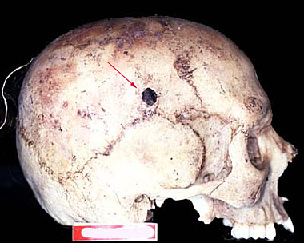
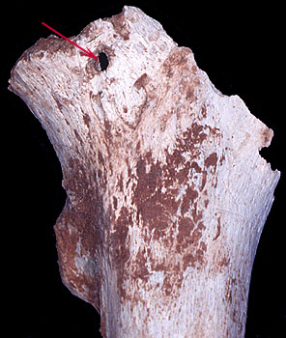
Other Information We Can Get From Bones:
Evidence of trauma (here GSW to the head)
Evidence of post mortem trauma (here the head of the femur was chewed off by a carnivore)
http://library.med.utah.edu/kw/osteo/forensics/index.html

Slide 39
Sources:
A good website with photos and information on forensic anthropology (including ancestry, sex and bullet holes):
  http://www.nlm.nih.gov/visibleproofs/education/anthropological/
A good site with a range of resources:
  http://www.forensicanthro.com/
Another good primer for determining informtion from bones:
  http://www.nifs.com.au/FactFiles/bones/how.asp?page=how&title=Forensic%20Anthropology
Great, interactive site:
  http://whyfiles.org/192forensic_anthro/

