Slide 1
Fingerprints
T. Trimpe 2006 http://sciencespot.net

Slide 2
Fingerprint Principles
According to criminal investigators, fingerprints follow 3 fundamental principles:
A fingerprint is an individual characteristic; no two people have been found with the exact same fingerprint pattern.
A fingerprint pattern will remain unchanged for the life of an individual; however, the print itself may change due to permanent scars and skin diseases.
Fingerprints have general characteristic ridge patterns that allow them to be systematically identified.

Slide 3
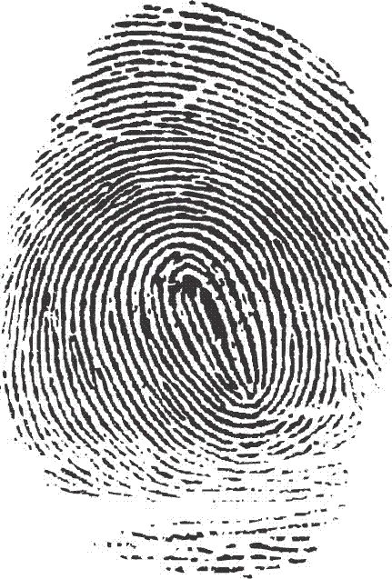
Fingerprint Classes
There are 3 specific classes for all fingerprints based
upon their visual pattern: arches, loops, and whorls.
Each group is divided into smaller groups
as seen in the lists below.
Arch
Plain arch
Tented arch
Loop
Radial Loop
Ulnar loop
Whorl
Plain whorl
Central pocket whorl
Double loop whorl
Accidentical

Slide 4
Interesting Info
Fingerprint Factoid:
60% of people have loops, 35% have whorls,
and 5% have arches
Did you know?
Dactyloscopy is the study of fingerprint identification.
Police investigators are experts in collecting “dactylograms”, otherwise known as fingerprints.
ADD TO NOTES

Slide 5
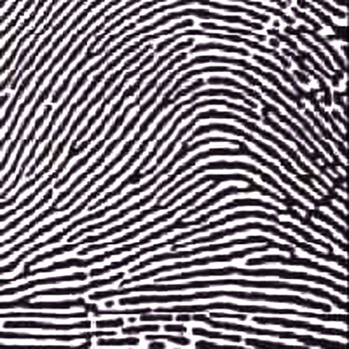
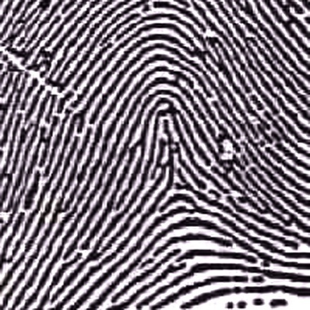
Arches
Arches are the simplest type of fingerprints that are formed by ridges that enter on one side of the print and exit on the other. No deltas are present.
Spike or “tent”
Plain Arch
Ridges enter on one side and
exit on the other side.
Tented Arches
Similar to the plain arch,
but has a spike in the center.

Slide 6
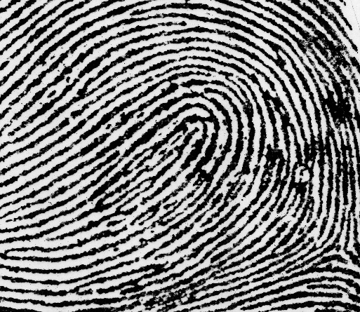
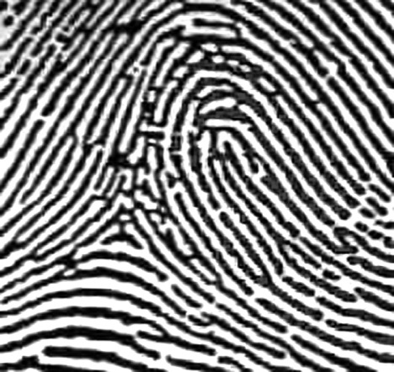
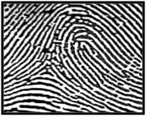
Loops
Loops must have one delta and one or more ridges that enter and leave on the same side. These patterns are named for their positions related to the radius and ulna bones.
Delta
Ulnar Loop (Right Thumb)
Loop opens toward
right or the ulna bone.
Radial Loop (Right Thumb)
Loop opens toward the
left or the radial bone.
NOTE: On the left hand, a loop that opens to the left would be an ulnar loop, while one that opens to the right would be a radial loop.

Slide 7
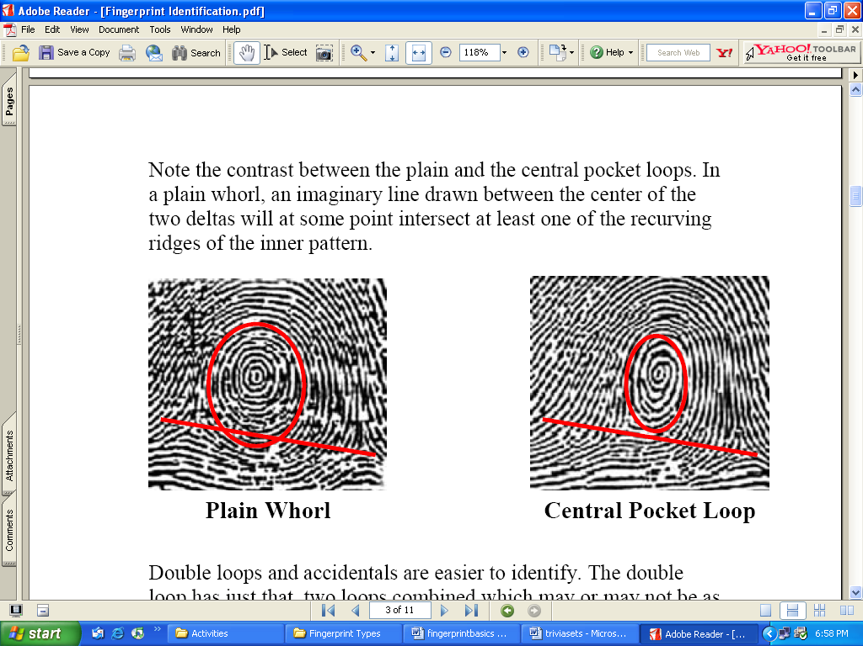
Whorls
Whorls have at least one ridge that makes (or tends to make) a complete circuit. They also have at least two deltas. If a print has more than two deltas, it is most likely an accidental.
Central Pocket Whorl
Plain Whorl
Draw a line between the two deltas in the plain and central pocket whorls. If some of the curved ridges touch the line, it is a plain whorl. If none of the center core touches the line, it is a central pocket whorl.

Slide 8
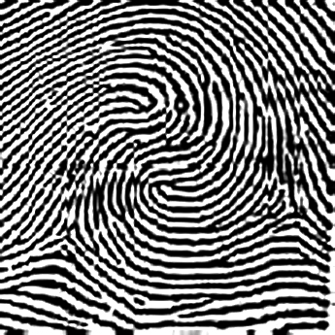
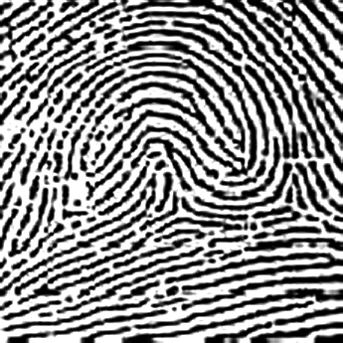
Whorls – Part 2
Double Loop Whorl
Accidental Whorl
Delta
Delta
Double loop whorls are made up of any two loops combined into one print.
Accidental whorls contain two or more patterns (not including the plain arch), or does not clearly fall under any of the other categories.

Slide 9
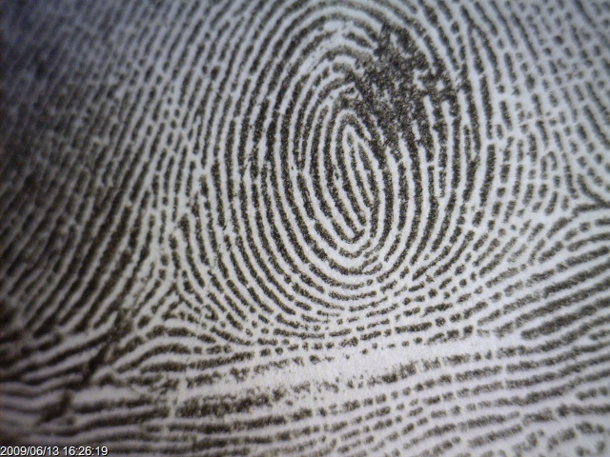
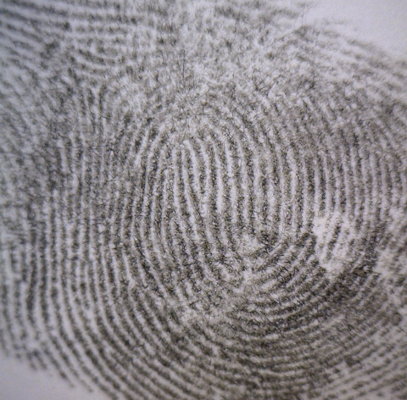
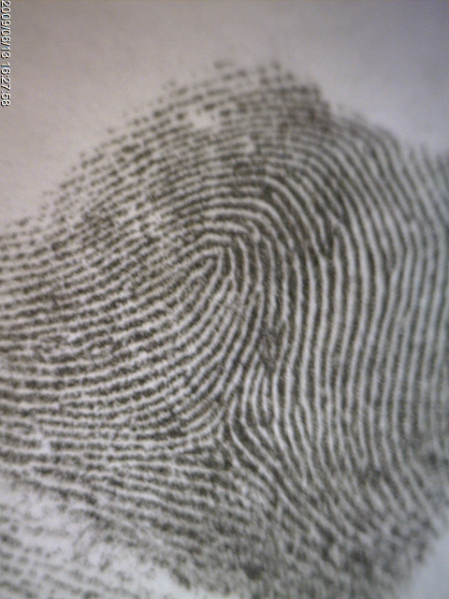
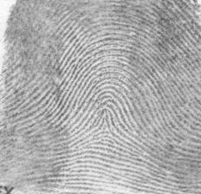
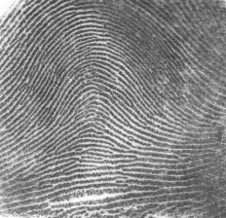
Identify each fingerprint pattern.
?
A
B
Left Hand
Right Hand
C
D
Right Hand
E
Right Hand
Left Hand
Notes:
Answer Key: A - Plain Whorl, B – Double Loop Whorl, C – Radial Loop, D – Tented Arch, E – Plain Arch

Slide 10
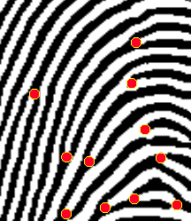

Ridgeology: The study of the uniqueness of friction ridge structures and their use for personal identification.¹
A fingerprint is made of a series of ridges and valleys on the surface of the finger. The uniqueness of a fingerprint can be determined by the pattern of ridges and valleys as well as the minutiae points, which are points where the ridge structure changes.
Fingerprint Identification
When minutiae on two different prints match, these are called points of similarity or points of identification. At this point there is no international standard for the number of points of identification required for a match between two fingerprints. However, the United Kingdom requires a minimum sixteen points while Australia requires twelve.
¹Introduction to Basic Ridgeology by David Ashbaugh, May 1999 Image from http://www.cs.usyd.edu.au/~irena/minutia.gif

Slide 11
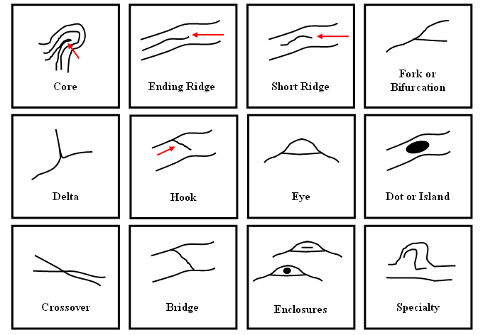
Ridge Characteristics
Use these characteristics as points of identification when comparing fingerprint samples. The more points you can find in common, the better the match!

Slide 12
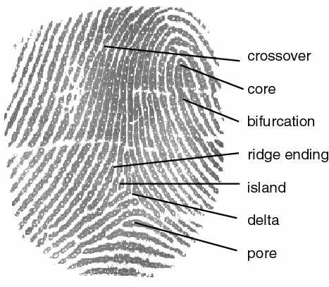
Ridge Characteristics
EXAMPLE
Crossover
Core
Bifurcation (fork)
Ridge ending
Scar
Island
Delta
Pore
http://cnx.org/content/m12574/latest/properties.jpg

Slide 13
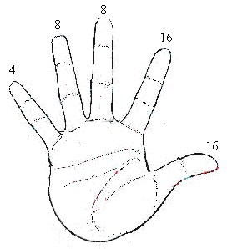
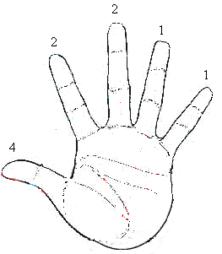
Primary Classification
The Henry—FBI Classification
Based on WHORLS
Each finger is given a point value
right
left

Slide 14
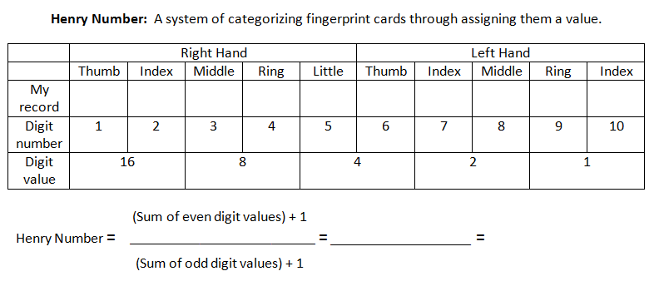
Primary Classification
Assign the number of points for each finger that has a whorl and substitute into the equation:
That number is your primary classification number

Slide 15
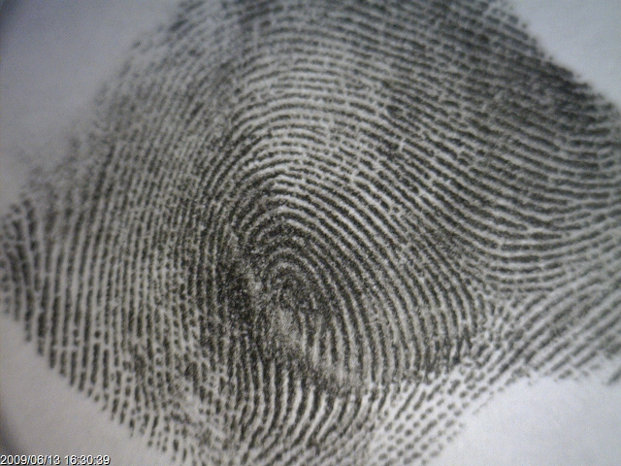
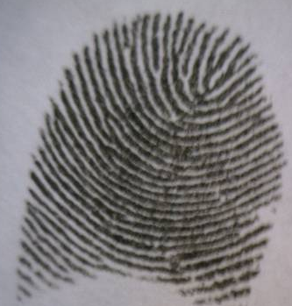
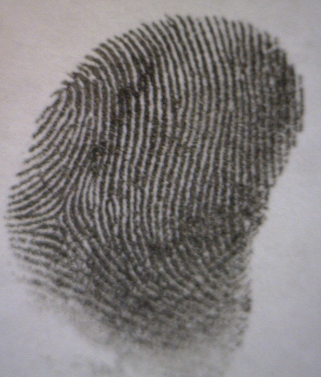
It’s time to make
some prints!
https://www.youtube.com/watch?v=d7N-4UNAzsw
Avoid Partial Prints
GOOD PRINT
Get as much of the top part of your finger as possible!

Slide 16
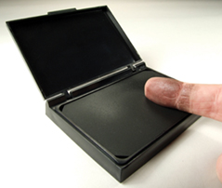
Directions
1st – Roll the “pad” portion of your thumb over the ink pad from the left side of your thumb to the right. You do not have to push down really hard!
2nd – Roll the “pad” portion of your thumb from the left side of your thumb to the right in the correct box on your paper to make a thumbprint.
3rd – Continue this process to make a fingerprint of all ten fingers on the “My Prints” worksheet.
4th –Use your notes and a magnifying lens to help you figure out what type of pattern is found in each of your fingerprints. Label each one with the pattern’s name.

