Slide 1
Crime Scene Basics
Forensic Science
T. Trimpe 2006 http://sciencespot.net

Slide 2
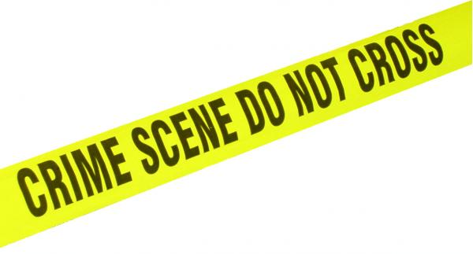
Crime Scene Vocabulary
CRIME SCENE: Any physical location in which a crime has occurred or is suspected of having occurred.
PRIMARY CRIME SCENE: The original location of a crime or accident.
SECONDARY CRIME SCENE: An alternate location where additional evidence may be found.
SUSPECT: Person thought to be capable of committing a crime.
ACCOMPLICE: Person associated with someone suspected of committing a crime.
ALIBI: Statement of where a suspect was at the time of a crime.
Source: http://www3.sc.maricopa.edu/ajs/crime_scene_technician.htm

Slide 3
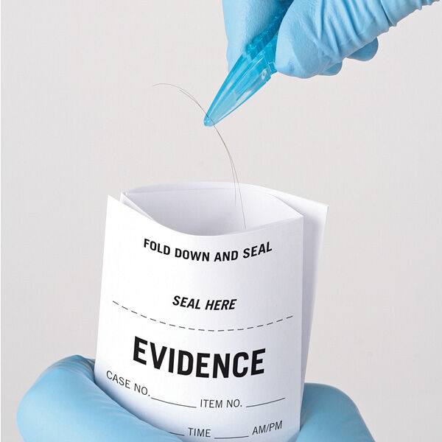
Types of Evidence
Testimonial evidence includes oral or written statements given to police as well as court testimony by people who witnessed an event.
Physical evidence refers to any material items that would be present at the crime scene, on the victims, or found in a suspect’s possession.
Trace Evidence refers to physical evidence that is found in small but measurable amounts, such as strands of hair, fibers, or skin cells.

Slide 4
Types of Evidence
Direct Evidence – evidence that, if true, proves an alleged fact. Examples include eyewitness accounts and video surveillance footage.
Circumstantial Evidence – indirect evidence. Evidence used to imply a fact but not prove it directly. Examples might be shoe print, receipts or trace evidence.
Class Evidence – material that connects an individual or thing to a certain group. Examples would be a brand insignia on a shoe imprint, paint chips from a vehicle, and a hair sample.
Individual Evidence – evidence that identifies a particular person or thing. Examples include fingerprint and DNA evidence.

Slide 5
Important Vocabulary
Chain of Custody – the documented and unbroken transfer of evidence.
Reasonable Forensic Certainty – the formal phrase used to qualify conclusions in court, when there is not absolute certainty. This term is used for most types of forensic science.
Absolute Forensic Certainty – the formal phrase used when there is absolute certainty. This is exclusively used with DNA evidence.

Slide 6
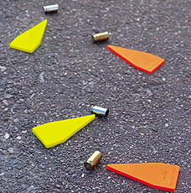
What will evidence collected at a scene do for the investigation?
May prove that a crime has been committed
Establish key elements of a crime
Link a suspect with a crime scene or a victim
Establish the identity of a victim or suspect
Corroborate verbal witness testimony
Exonerate the innocent.
Give detectives leads to work with in the case
Source: http://www3.sc.maricopa.edu/ajs/crime_scene_technician.htm

Slide 7
Crime Scene Personnel
POLICE OFFICERS are typically the first to arrive at a crime scene. They are responsible for securing the scene so no evidence is destroyed and detaining persons of interest in the crime.
The CSI UNIT documents the crime scene in detail and collects any physical evidence.
The DISTRICT ATTORNEY is often present to help determine if any search warrants are required to proceed and obtains those warrants from a judge.
The MEDICAL EXAMINER (if a homicide) may or may not be present to determine a preliminary cause of death.
SPECIALISTS (forensic entomologists, anthropologists, or psychologists) may be called in if the evidence requires expert analysis.
DETECTIVES interview witnesses and consult with the CSI unit. They investigate the crime by following leads provided by witnesses and physical evidence.
Source: http://science.howstuffworks.com/csi.htm

Slide 8
Crime Scene Protocol
Step 1: Interview
The first step in investigating a crime scene is to interview the first officer at the scene or the victim to determine what allegedly happened, what crime took place, and how was the crime committed. This information may not be factual information but it will give the investigators a place to start.
Step 2: Examine
The second step in the investigation of a crime scene, which will help identify possible evidence, identify the point of entry and point of exit, and outline the general layout of the crime scene.
Step 3: Document
The third step in the protocol involves creating a pictorial record of the scene as well as a rough sketch to demonstrate the layout of the crime scene and to identify the exact position of the deceased victim or other evidence within the crime scene.
Step 4: Process
This is the last step in the protocol. The crime scene technician will process the crime scene for evidence, both physical and testimonial evidence. It is the crime scene technicians responsibility to identify, evaluate and collect physical evidence from the crime scene for further analysis by a crime laboratory.
Adapted from http://www.feinc.net/cs-proc.htm

Slide 9
Investigating the Evidence
Forensic Science disciplines at the
Illinois State Police Crime Labs
Drug Chemistry – Determines the presence of controlled substances and the identification of marijuana
Trace Chemistry - Identification and comparison of materials from fires, explosions, paints, and glass.
Microscopy – Microscopic identification and comparison of evidence, such as hairs, fibers, woods, soils, building materials, insulation and other materials.
Biology/DNA – Analysis of body fluids and dried stains such as blood, semen, and saliva.
Toxicology – Tests body fluids and tissues to determine the presence of drugs and poisons.
Latent Prints - Identification and comparison of fingerprints or other hidden impressions from sources like feet, shoes, ears, lips or the tread on vehicle tires.
Ballistics (Firearms) – Study of bullets and ammunition through the comparison of fired bullets, cartridges, guns, and gunpowder patterns on people and objects.
Toolmarks – Examines marks left by tools on objects at a crime scene or on a victim, such as a hammer used to break a door or a screwdriver used to pick a lock.
Questioned Documents - Examination of documents to compare handwriting, ink, paper, writing instruments, printers, and other characteristics that would help to identify its origin.
Source: http://www.isp.state.il.us/forensics/

Slide 10
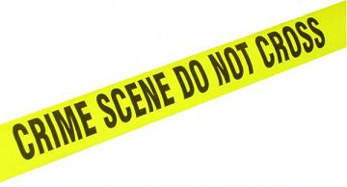
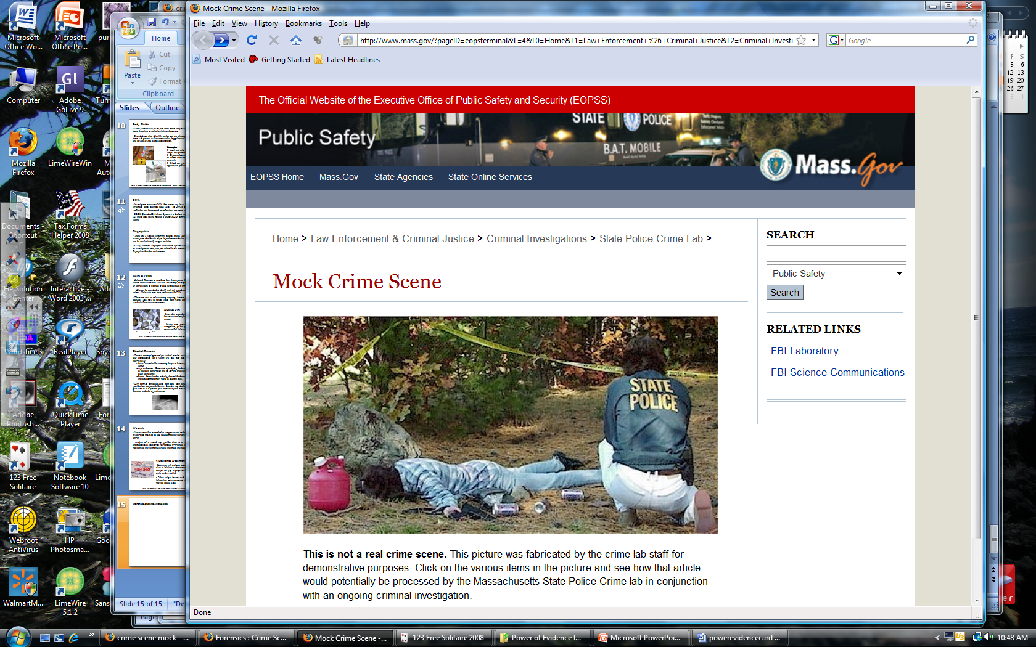
What evidence would you collect?
Mock Crime Scene: http://www.masss.gov

