Slide 1
Blood Spatter

Slide 2
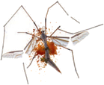
Spatter, NOT Splatter!
Bugs splatter
Blood spatters

Slide 3
When a wound is inflicted and blood leaves the body, a blood-spatter pattern may be created.
A single stain or drop of blood does not constitute a spatter.

Slide 4
A blood spatter can help reconstruct the series of events surrounding a shooting, stabbing, or beating.

Slide 5
History of Blood Spatter
1894 – Pitoroski wrote the earliest reference to blood spatter
1939 – Balthazard first researcher to analyze the meaning of spatter pattern
1955 – blood spatter evidence used in the Sam Shepard case, helping to exonerate him
1971 – Dr. Herbert McDonnell used blood-spatter analysis as tool in forensic examination

Slide 6
Analysis
Given blood-spatter patterns, it is possible to determine
the direction the blood was traveling,
the angle of impact,
the point of origin of the blood
determine manner of death
based on the blood velocity

Slide 7
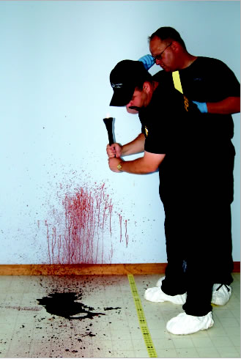
Did you ever wonder why blood forms droplets as it falls from the wound?
Why doesn’t it separate in the air before it hits the ground or an object?
Answer – have to do with when forces of gravity, cohesion, adhesion, and surface tension act on blood.

Slide 8
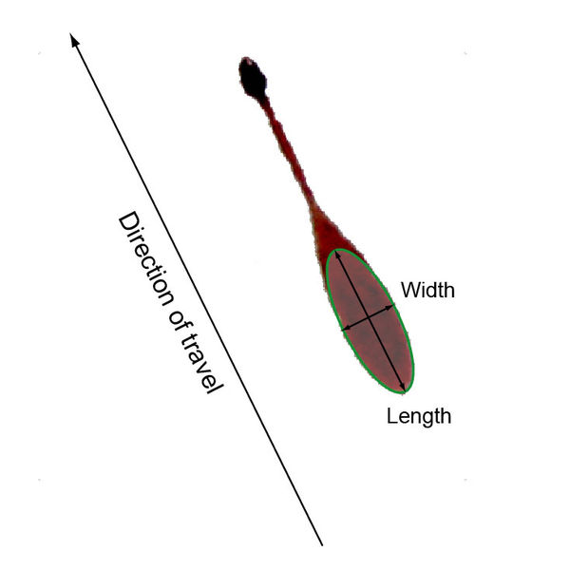
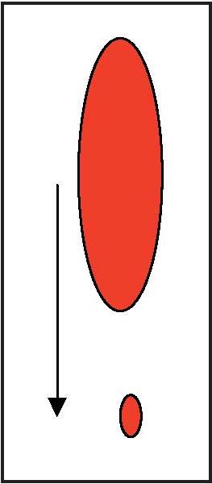
Properties of Blood
Gravity: pulls it to ground
Droplet becomes longer than wide
Cohesion: blood mixture is attracted to similar blood mixtures and sticks together, not separates, as it falls
Causes droplet to stay together
Adhesion: attractive forces of two different objects
starts as teardrop because of adhesion
Surface Tension: the elastic like property of the surface of the liquid that makes it tend to contract, caused by the forces of attraction between the molecules of the liquid.
Formation of a sphere

Slide 9
Recall that blood is a thick mixture of blood cells and plasma.
When a person is bleeding, gravity acts on blood, pulling it downward toward the ground.
Being cohesive- the blood mixture is attracted to similar blood mixtures and tends to stick together and not separate as it falls.

Slide 10
When blood falls on a flat surface
The blood drop will have a curved surface
The blood drop does not totally flatten out
Cohesion- sticking together!
Surface is elastic, giving the top of the blood spatter a spherical shape.

Slide 11
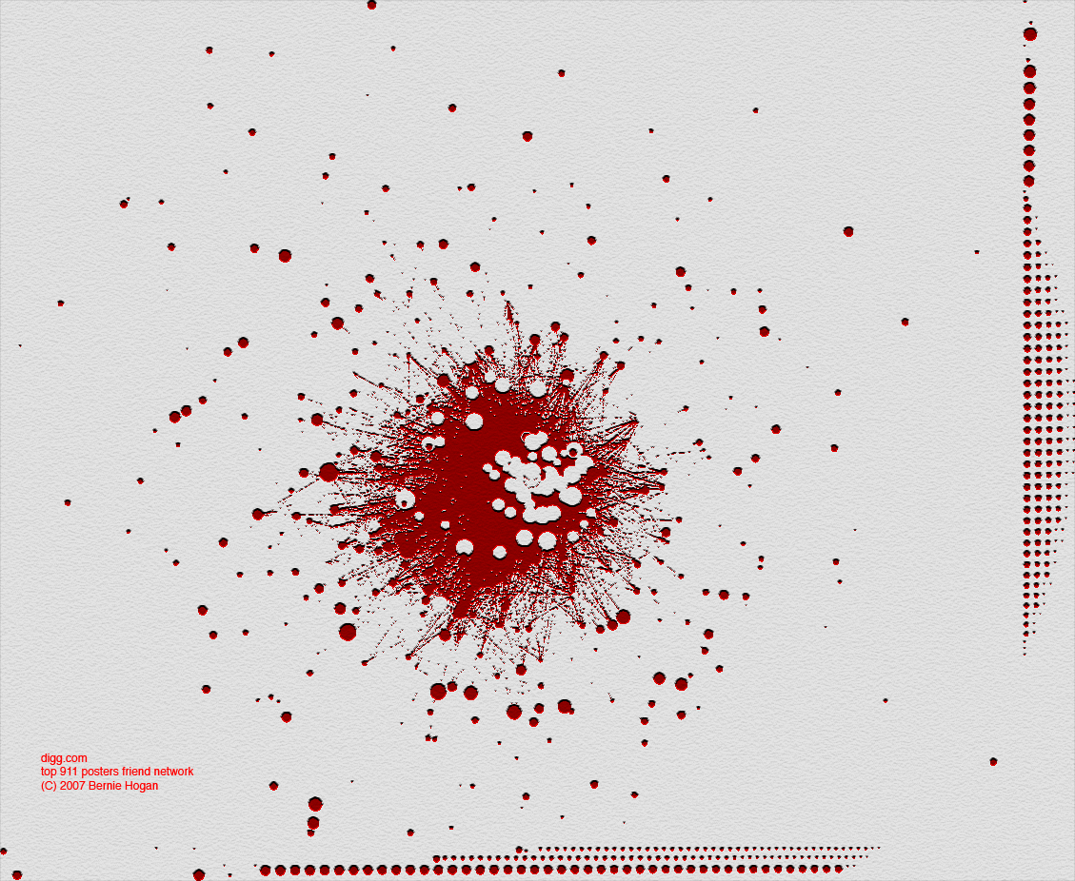
If any of the blood does overcome cohesion…
Separates from the main droplet of blood
Forms secondary droplets
These are known as Satellites

Slide 12
If blood is dropped onto a smooth surface
Such as glass or marble
The edge of the blood drop is smooth and circular.
If blood is dropped on a porous surface
such as wood or ceiling tile
The edge of the blood drop may form small spikes that are still connected to the main droplet of blood.

Slide 13
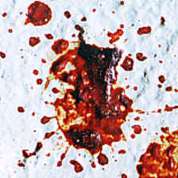
Blood Droplets
Flat surface – edge of blood drop appears smooth and circular
Glass, marble
Porous surface – edge of drop of blood may form small spikes (extensions) or satellites
Spines – attached to make droplet
Satellites – not attached to main droplet

Slide 14
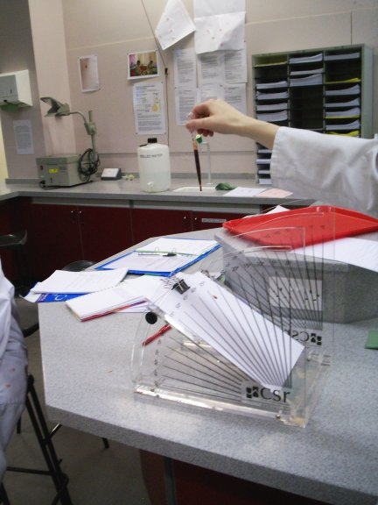
In1909 Dr. John Glaister first described the six patterns into which blood spatters could be classified.

Slide 15
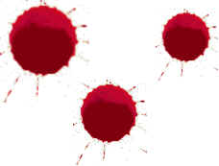
Six Patterns Blood can be classified:
Passive Fall - Blood falling directly to floor at 90-degree angle will produce circular drops, with more secondary satellites being produced if the surface it hits is textured

Slide 16
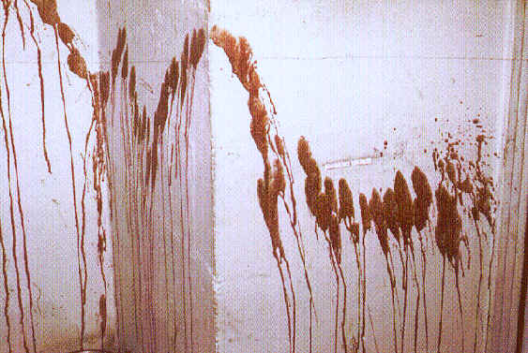
Six Patterns Blood can be classified:
Arterial spurts or gushes – typically found on walls or ceilings caused by pumping action of the heart

Slide 17
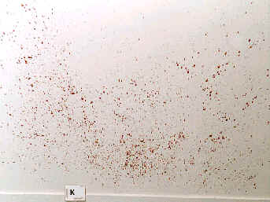
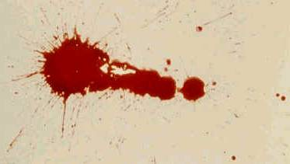
Six Patterns Blood can be classified:
Splashes – shaped like exclamation points.
Shape and position of spatter pattern can help locate the position of the victim at the time of the attack

Slide 18
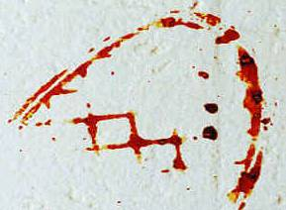
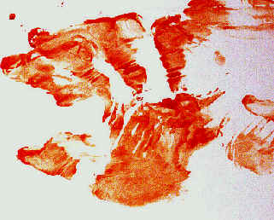
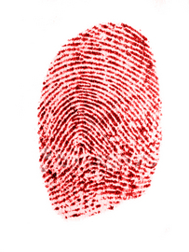
Six Patterns Blood can be classified:
Smears – left by bleeding victim depositing blood as he or she touches or brushes against a wall or furniture
transfers

Slide 19
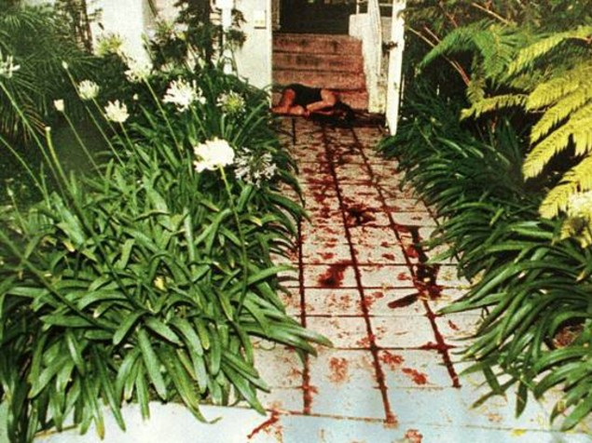
Six Patterns Blood can be classified:
Trails – can be left by bleeding victim depositing blood as he or she moves from one location to another.
Can be round, smeared, appear as spurts

Slide 20
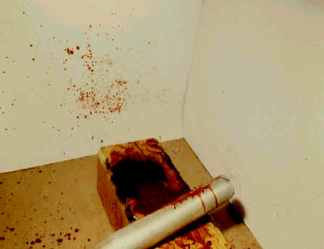
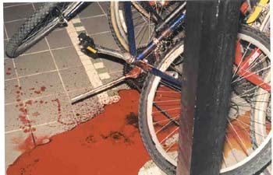
Six Patterns Blood can be classified:
Pools – form around victim who is bleeding heavily and remains in one place.
If victim is moved to another location, there may be droplets or smearing connecting the first location with a second

Slide 21
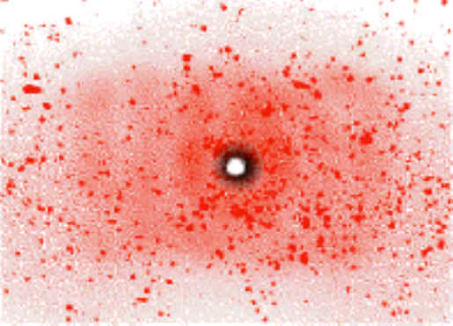
Spatter Patterns and Type of Wound
High Velocity Impact (100 ft/sec) – fine-mist spatter pattern
Size of Droplets – less than 1 mm
Ex. Gunshot wound

Slide 22
Spatter Patterns and Type of Wound
Medium-Velocity Impact (25 ft/sec)
Size – 1-4 mm
Ex. – beating, stabbing

Slide 23
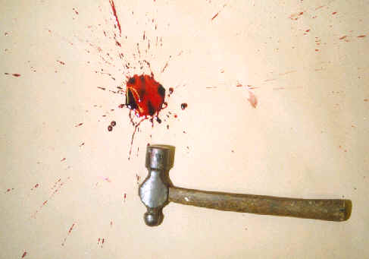
Spatter Patterns and Type of Wound
Low-Velocity Impact (5 ft/sec)
Size – 4 to 6 mm
Ex – blunt object impact (hammer, flashlight, etc)

Slide 24
Examination of Directionality of Blood
Shape provides clues to direction from which blood originated
Circular drop (width = length) – fell straight down
Typical of dripping wound (passive)
Elongated drop (width < length) – possible to determine direction blood was traveling
When blood comes into contact with another surface, it adheres or sticks to it
Point of impact may appear darker and wider than rest of drop of blood spatter

Slide 25
Examination of Directionality of Blood
Momentum – keeps blood moving in direction it was traveling
As droplet moves away from source, it elongates and may produce a thinner, tail-like appearance
Tail points in direction of blood’s movement
Satellites or secondary drops may appear in front of moving droplet of blood

Slide 26
Blood Spatter and Angle of Impact
ANGLE of IMPACT - the acute angle formed between the direction of the blood drop and the plane of the surface it strikes.

Slide 27
Angle of Impact Calculations
accurately measuring the length and width of a bloodstain, the impact angle can be calculated using the SIN formula below:
AOI = SIN-1 W / L
W – Width of blood drop
L – Length of blood drop

Slide 28
EXAMPLE
Finding AOI
LENGTH = 5.9cm
WIDTH = 2.6cm

Slide 29
SOLUTION:
AOI = SIN⁻¹ W / L
AOI = SIN⁻¹ 2.6/5.9
AOI = SIN⁻¹ (.44)
AOI = 26.2°

Slide 30
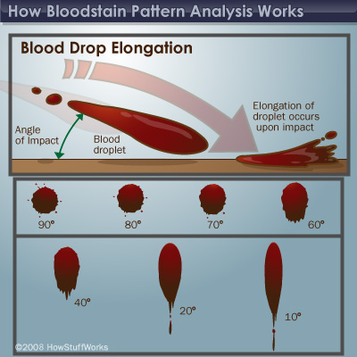

Slide 31
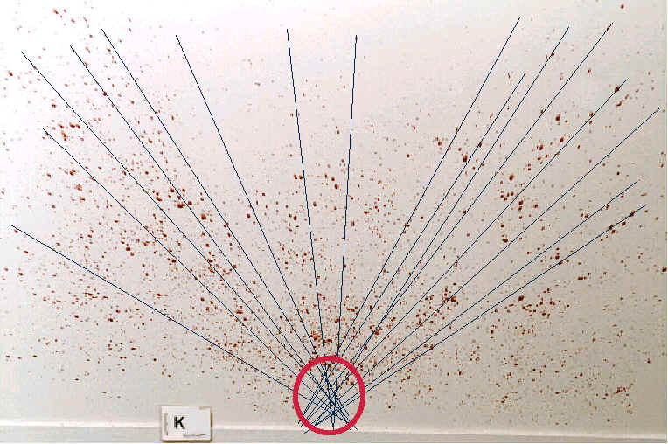
Lines of Convergence
Location of source can be determined if there are at least two drops of blood spatter.
Lines of Convergence – found by drawing straight lines down the long axis of blood spatter and noting where they intersect
2D view of the location of the source

Slide 32
Point of Origin
lies at a point in space above the point of convergence.
Measurement of the impact angle allows for translation of the 2-D image (convergence) into a 3-D one (origin).

Slide 33
Point of Origin
First measure the distance from each blood stain along its central axis to the POC (distance = y)
Then take the TAN of the degrees AOI.
Third, multiply the TAN of the AOI by the distance.
Measure that distance from the floor up the perpendicular axis and you will arrive at the Point of Origin (PO)
FORMULA: PO = TAN (AOI) x y

Slide 34
EXAMPLE
Finding PO
GIVEN:
DISTANCE FROM BLOODSTAIN (to POC): 90cm AOI (calculated from AOI formula): 30°
SOLUTION:
PO = TAN (30°) x 90cm
PO = .577 x 90cm
= 52cm

Slide 36
Computer Programs Used

Slide 37
Falling directly to floor @ 90 degree angle will produce circular drops, with secondary satellites being more produced in the surface hit is textured. – known as a passive fall.
Arterial spurts or gushes typically found on walls or ceilings are caused by the pumping actions of the heart.

Slide 38
3. Splashes are shaped like exclamation points. The shape and position of the spatter pattern can help locate the position of the victim at the time of attack.
4. Smears are left by the bleeding victim depositing blood as he or she touches or brushes against furniture or walls.

Slide 39
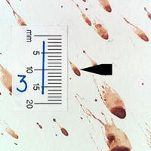
5. Trails of blood can be left by a bleeding victim as he or she moves from one location to another. The droplets could be round or smeared or even appear as spurts.
6. Pools of blood form around a victim who is bleeding heavily and remains in one place.

